Slide 1
How Well Does Your Web Presence take AIM?
Does it
Attract
Impress &
Motivate
the web surfing public,
and your future patients?

Slide 2
The “A” In Taking AIM With Your Website
Attracting your visitors via…
Conventional Strategies
“bricks to clicks”
Digital Marketing
  Natural aka Organic, and
  Paid aka Pay Per Click
  Social Media Optimization

Slide 3

The Courtship Of Google and Social Media
“First Date”
  Does the practice (website) have an associated social media presence?
“Second Date
  How many followers, likers, connections, etc. does the practice’s social media presence have (quantity)?
“Third Date
  Where are these connections located (quality)
“Fourth Date”
  What is the volume/consistency of posts (outreach)?
Present ”Relationship”
  What is the level of ENGAGEMENT?

Slide 4
Facts about Social Media Marketing
Online adults aged 18-34 are most likely follow a brand via social networking (95%).
71% of consumers who have had a good social media service experience with a brand are likely to recommend it to others.
2.56 billion global mobile social media users, equaling 34% penetration; globally 1 million new active mobile social users added every day
There are more than 50 million small businesses using Facebook Pages to connect with their customers. Your competitors are probably among them.
41% of Americans say it’s important that the institutions they engage with have a strong social media presence.

Slide 5
Social media ‘humanizes ‘your practice more than any other medium. Your team begins to feel like a family, and trips to the dentist feel less scary because there is a personal relationship.

Slide 6
The “I” In Taking AIM With Your Website
Impressing The Visitor
The true value of web searches comes from what people do with your content once found.
Your first impression is the most important. Your website must present you as professional, knowledgeable, and helpful.
Do not allow too much time to pass between a potential patient thinking about connecting to you and following through. Setting appointments and reaching out should be easy and painless.
Track all sources for new patients, and be nimble and proactive about custom strategies for each source.

Slide 7
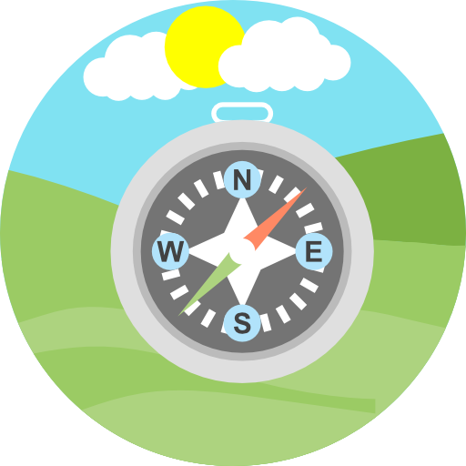
Key Components of An
Impressive Website
Ease of Navigation
and
Simplicity

Slide 8
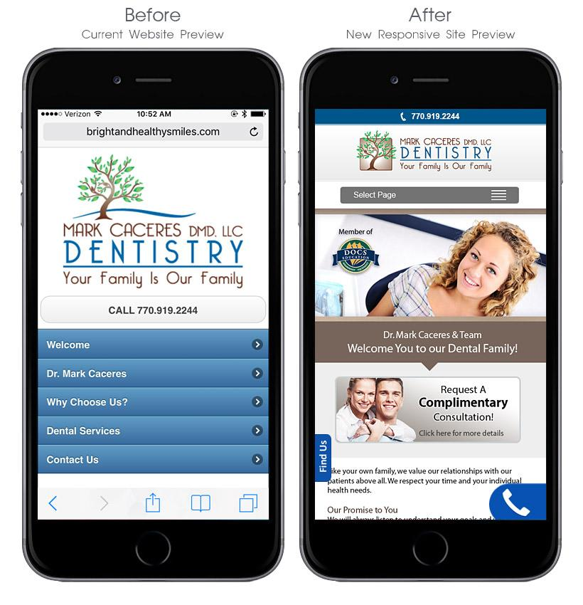
Is Your Website
Fully Responsive?
There is a difference between “responsive” and “mobile ready.”
The ‘After’ example performs like your regular website- engaging, easy to navigate, and responsive to different screen sizes.

Slide 9
What grabs attention?
VIDEO… lots of video!
Animated Procedure Videos
Custom Practice Videos
Patient Testimonials

Slide 10
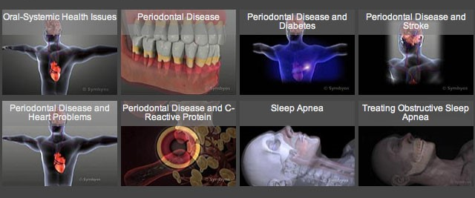
Oral Systemic Health
Educational Videos
Notes:
https://www.toothiq.com/oral-systemic/

Slide 11
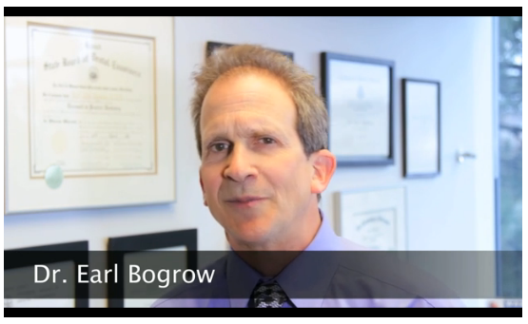
Custom Practice Video

Slide 12

Master the ability
to collect GREAT
Patient
Testimonial
Videos

Slide 13
Motivating The Visitor
The “M” In Taking AIM With Your Website

Slide 14
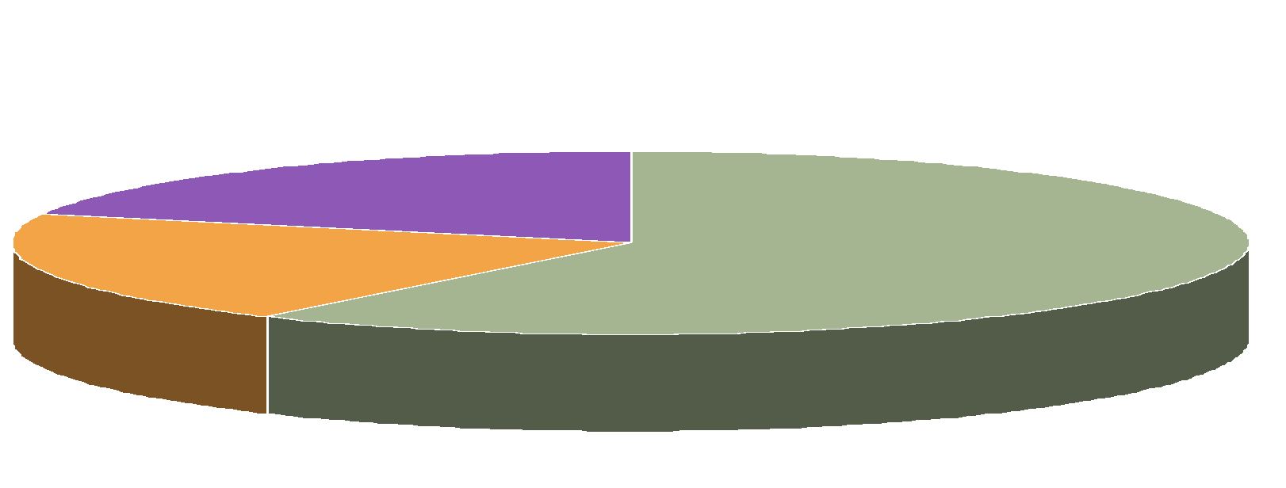
Website Visitors Fall Into One of Three Categories
20% Of Potential Patients will Appoint Immediately.
20% Will Probably Never Appoint.
60% Of Potential Patients Are Left. What Happens To Them???

Slide 15
20% Of Potential Patients will Appoint Immediately
This is the segment of potential patients that every website targets and, because your Internet and conventional marketing strategies have gotten you in front of the prospective patient, and directed them to your website, you’re well positioned to enroll them as a new patient.

Slide 16

The Forgotten 60 Percent
How is it done?
The remaining 60% of people who look for information are likely to buy within 1 year.
Amazingly, though, most dentists don’t know how to target this huge source of potential patients!
Notes:
Attribution of “20/20/60?”
Great to include slides showing sample reports and follow ups. Any way to get me audio to include with this???

Slide 17



Converting The Lead
Let’s say someone goes to Google and searches “tooth whitening.” Since you’ve set up a PPC campaign, and Optimized the site, yours is one of the top results, so visitors “click through” to the site’s Tooth Whitening page.
Instead of a page with “cookie-cutter” information, you offer them e.g. the “Special Report: 2 Easy Steps to the Bright White Smile You’ve Always Dreamed of.”
The visitor completes a contact information page after reading some general information. They then receive the Special Report via email.
Notes:
Concern is that PPC is an option not included and we seem to leap to it out of the blue

Slide 18
Establish Your Credibility
Once they receive their report, you’ve begun the process of establishing yourself as a trusted expert, which is key to enrolling new patients.

Slide 19

Keep In Touch
You’ve captured the visitor’s contact information, and delivered on your first promise.
Now, over the next year, your site will automatically stay in touch with them so that, when they’re ready to commit, you are the only dentist on their mind!

Slide 20
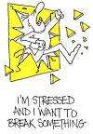
This sounds like a lot of work!!!
That’s why so few dentists target ‘the Forgotten 60%.’ Follow up marketing has proven to be successful. It’s just a logistical nightmare!
That’s where Connections™
comes in!

Slide 21
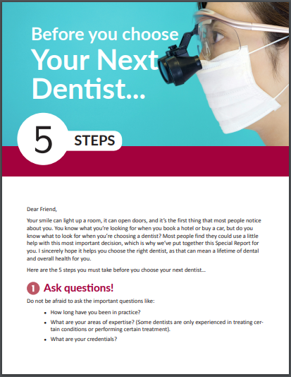
Here’s an Example:
Day 1- Email “Special Report”
Day 5- Connections™ Issue #1
Day 14- Connections™ Issue #2
Day 28- Connections™ Issue #3
Day 42- Connections™ Issue #4
Day 56- Connections™ Issue #5
Day 70- Connections™ Issue #6
and so on, until…
Day 340- Connections™ Issue #16
That’s nearly a year’s worth of automated communications!

Slide 22
Questions
???

